Slide 1
Crafting clean Java
Language features that simplify code

Slide 2
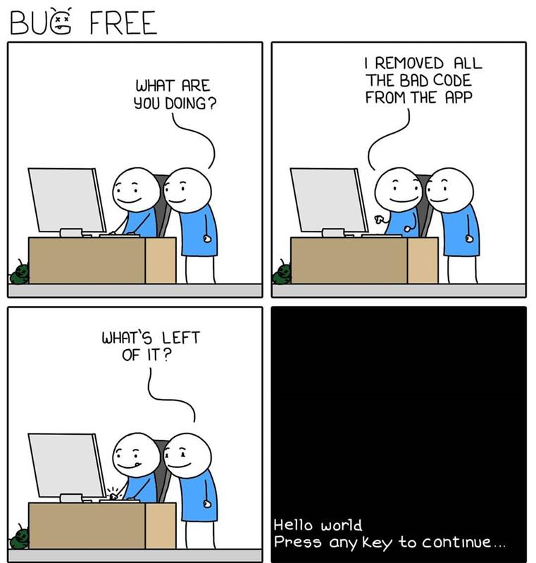

Slide 3
What is Clean Java & Why Refactor?
What is Clean Java?
Code that is readable, maintainable, and expressive
Follows minimalism: avoids unnecessary complexity or duplication
Emphasizes clarity of intent over cleverness
Enables easier testing, debugging, and onboarding
Why Craft Clean Java with Refactoring?
Legacy code often suffers from boilerplate and verbosity
Evolving Java features offer language-level improvements

Slide 4
var – Local Variable Type Inference
What:
Introduced in Java 10 (standard)
Allows using var to declare local variables with inferred types
Syntax: var name = "John"; → compiler infers String
Why:
Reduces boilerplate for obvious types
Improves readability when the type is clear from context

Slide 5
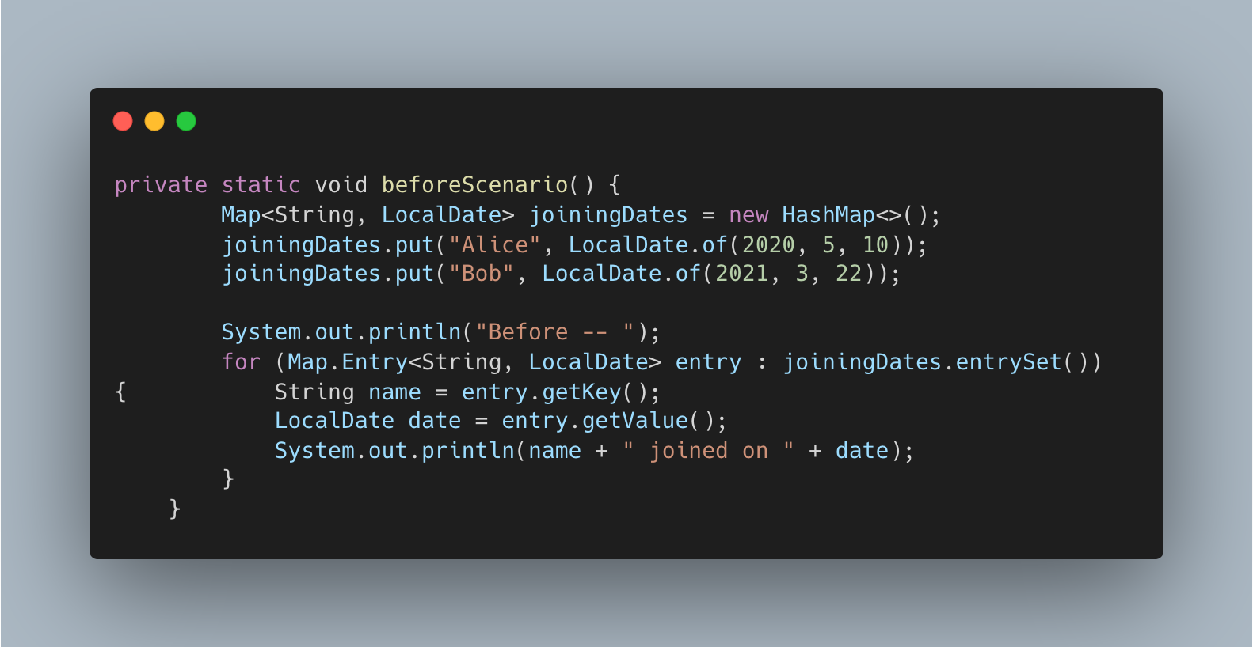

Slide 6
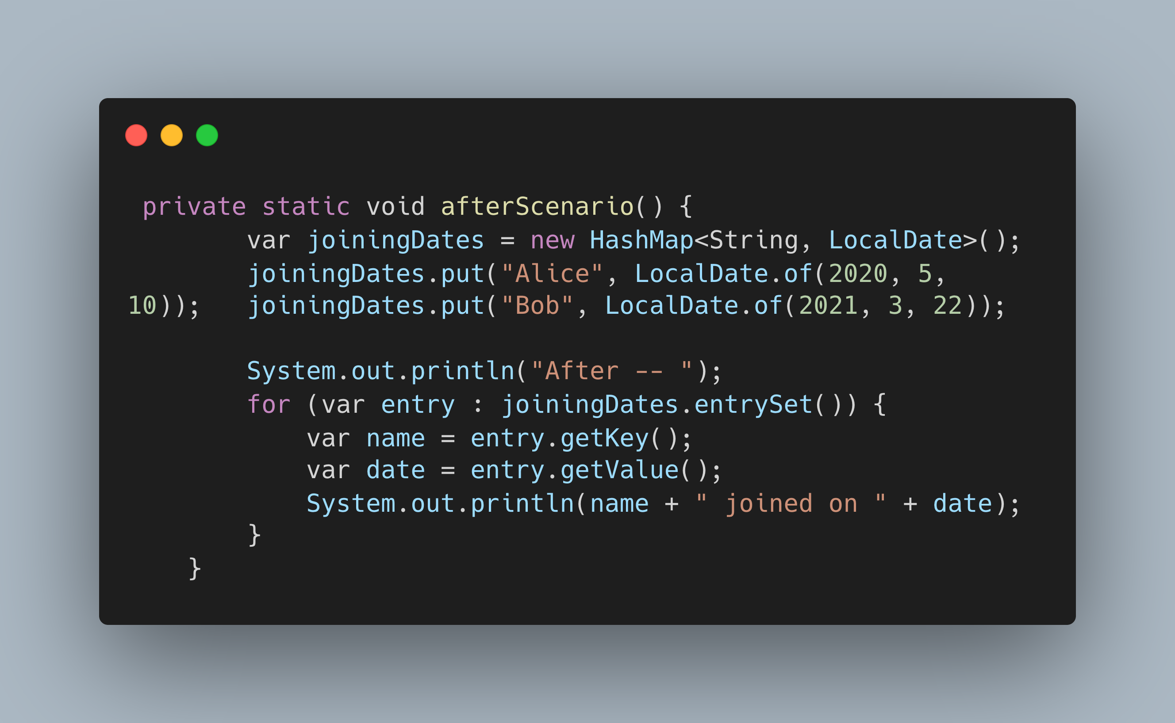

Slide 7
New String methods
What:
Introduced in Java 11 (standard)
Added methods: isBlank(), lines(), strip(), stripLeading(), stripTrailing(), repeat()
Why:
Simplifies common string operations without external libraries
Unicode-aware trimming (replaces trim())
Enables cleaner code with fewer helper methods

Slide 8
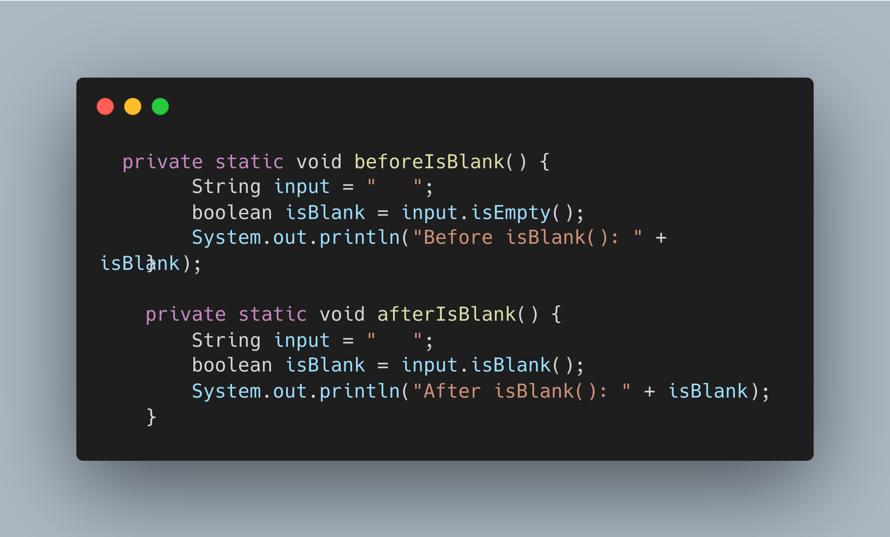

Slide 9
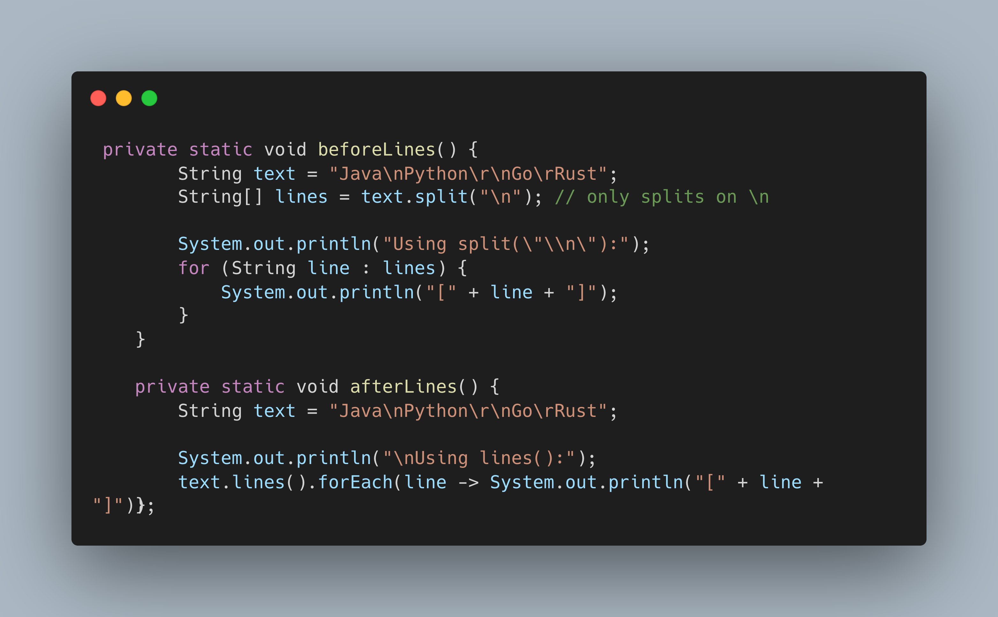

Slide 10
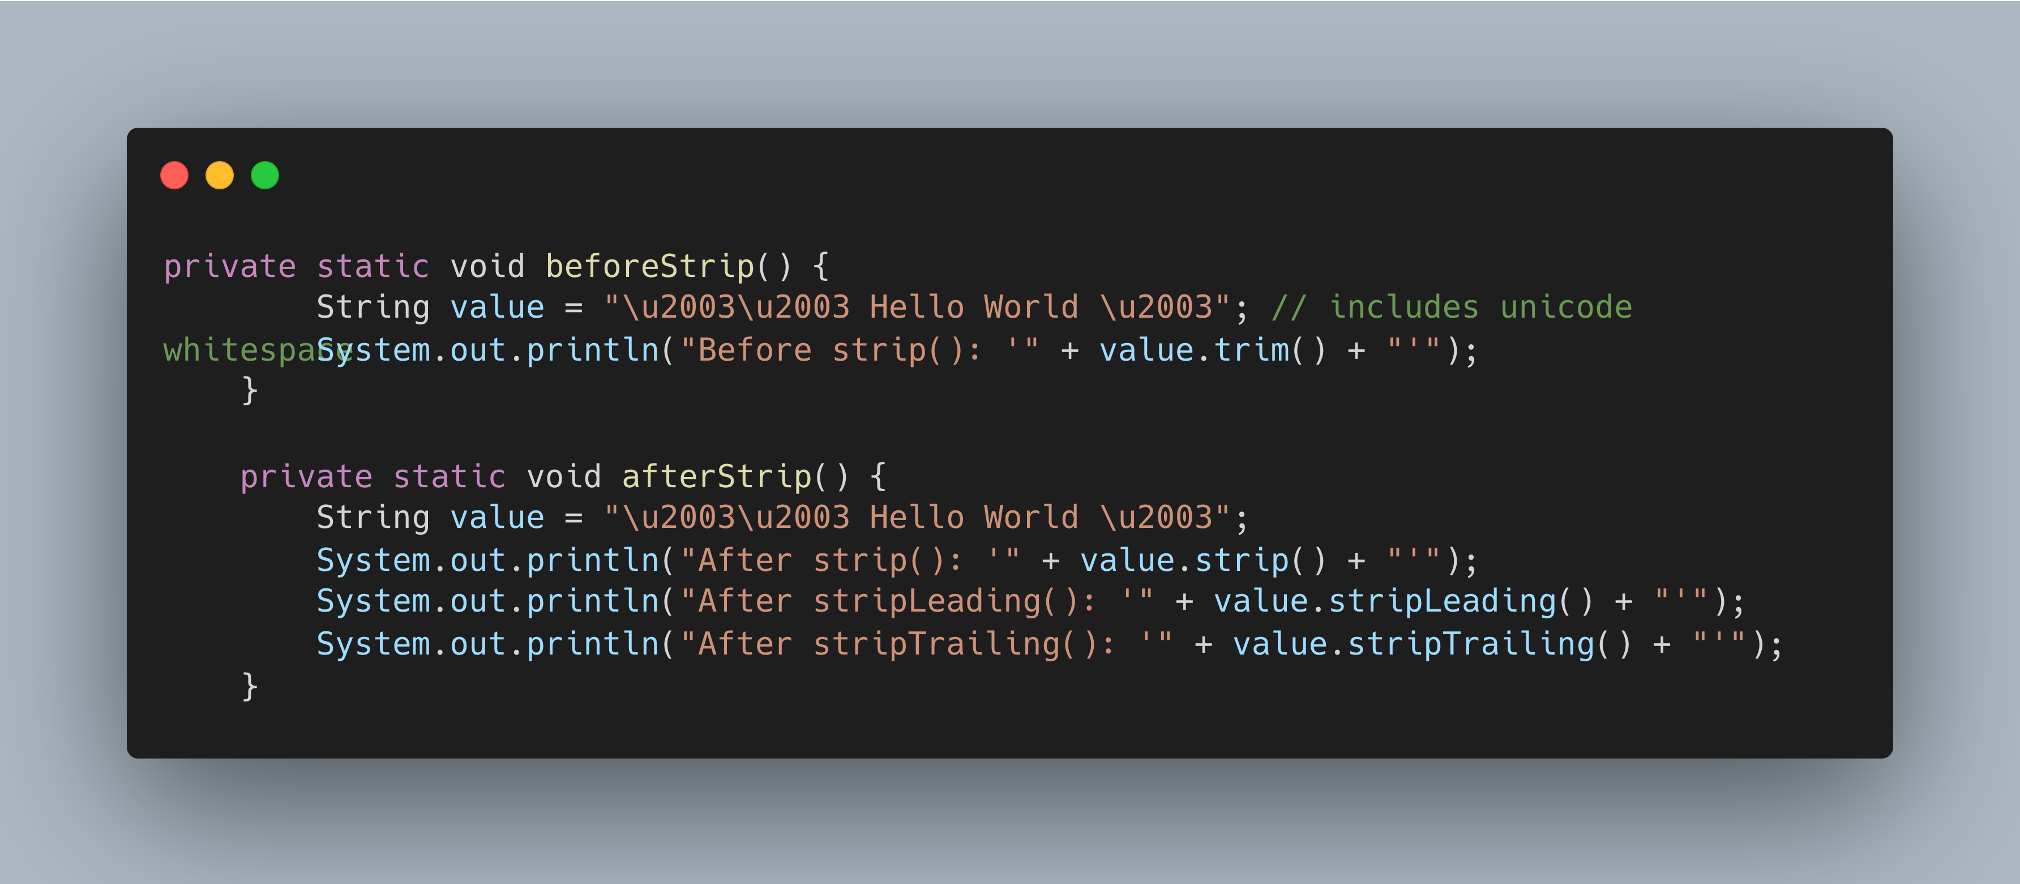

Slide 11
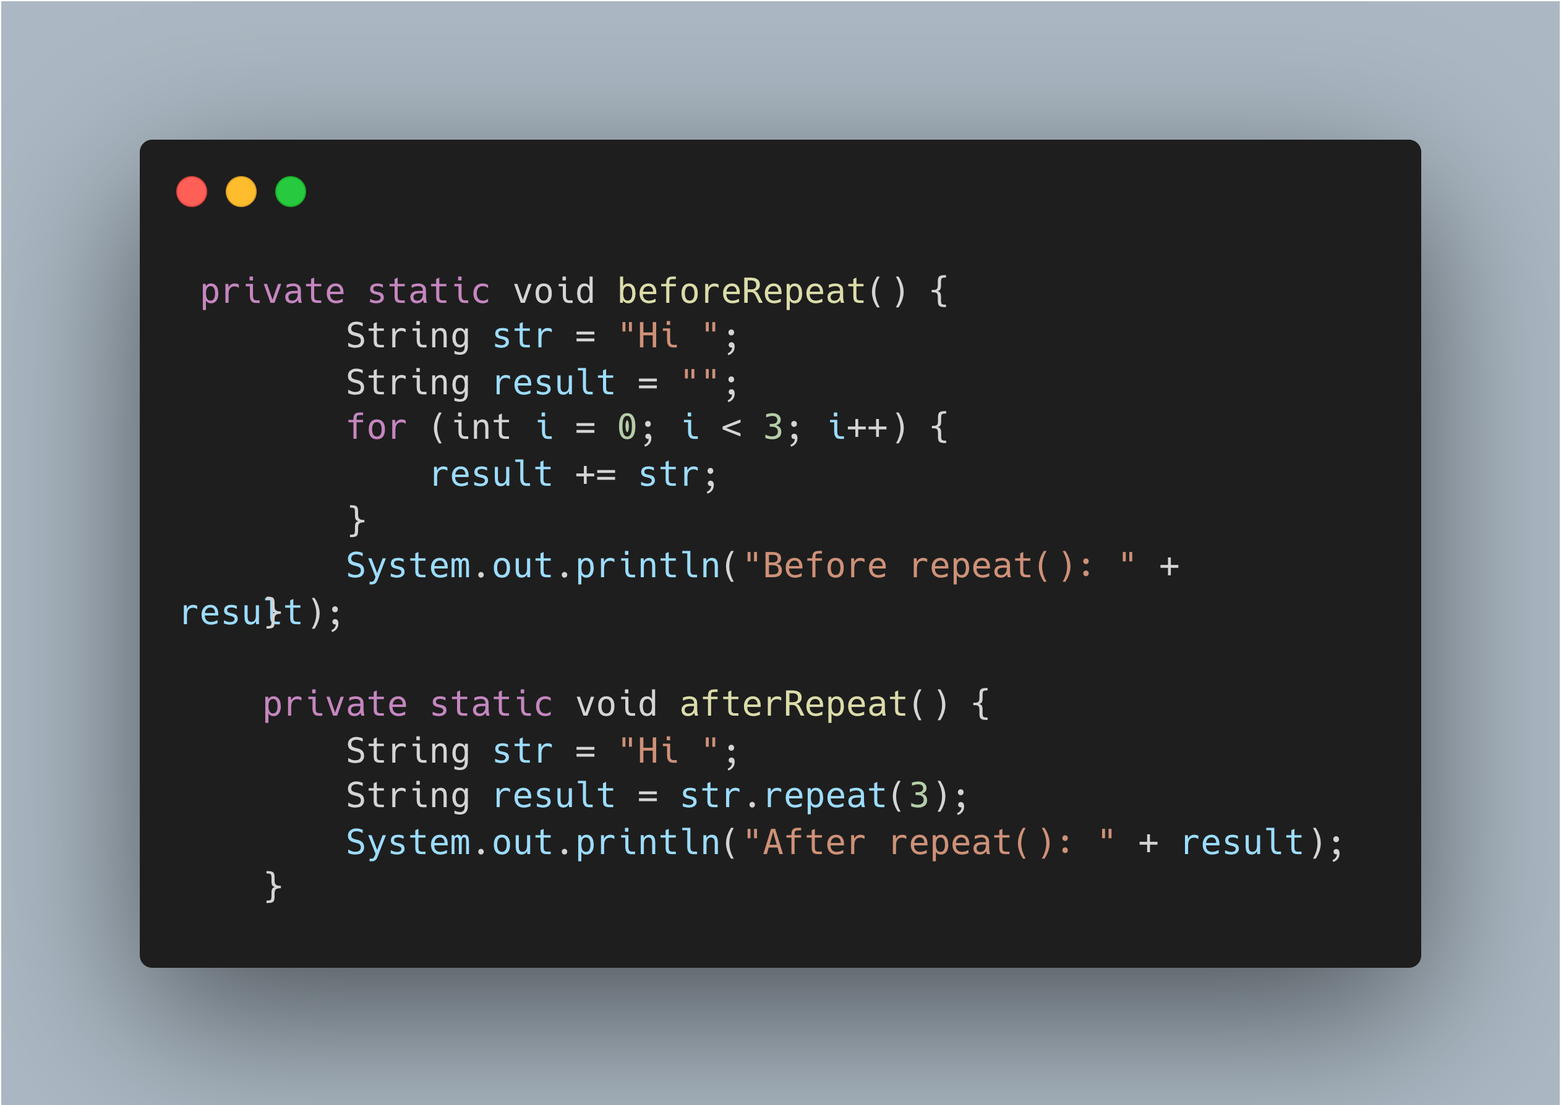

Slide 12
Compact Number Formatting
What:
Introduced in Java 12 (standard)
getCompactNumberInstance()
Formats numbers in a shortened, human-readable form (e.g., 1K, 2M)
Why:
Eliminates the need for custom number shortening logic
Enhances readability in UI and reports

Slide 13
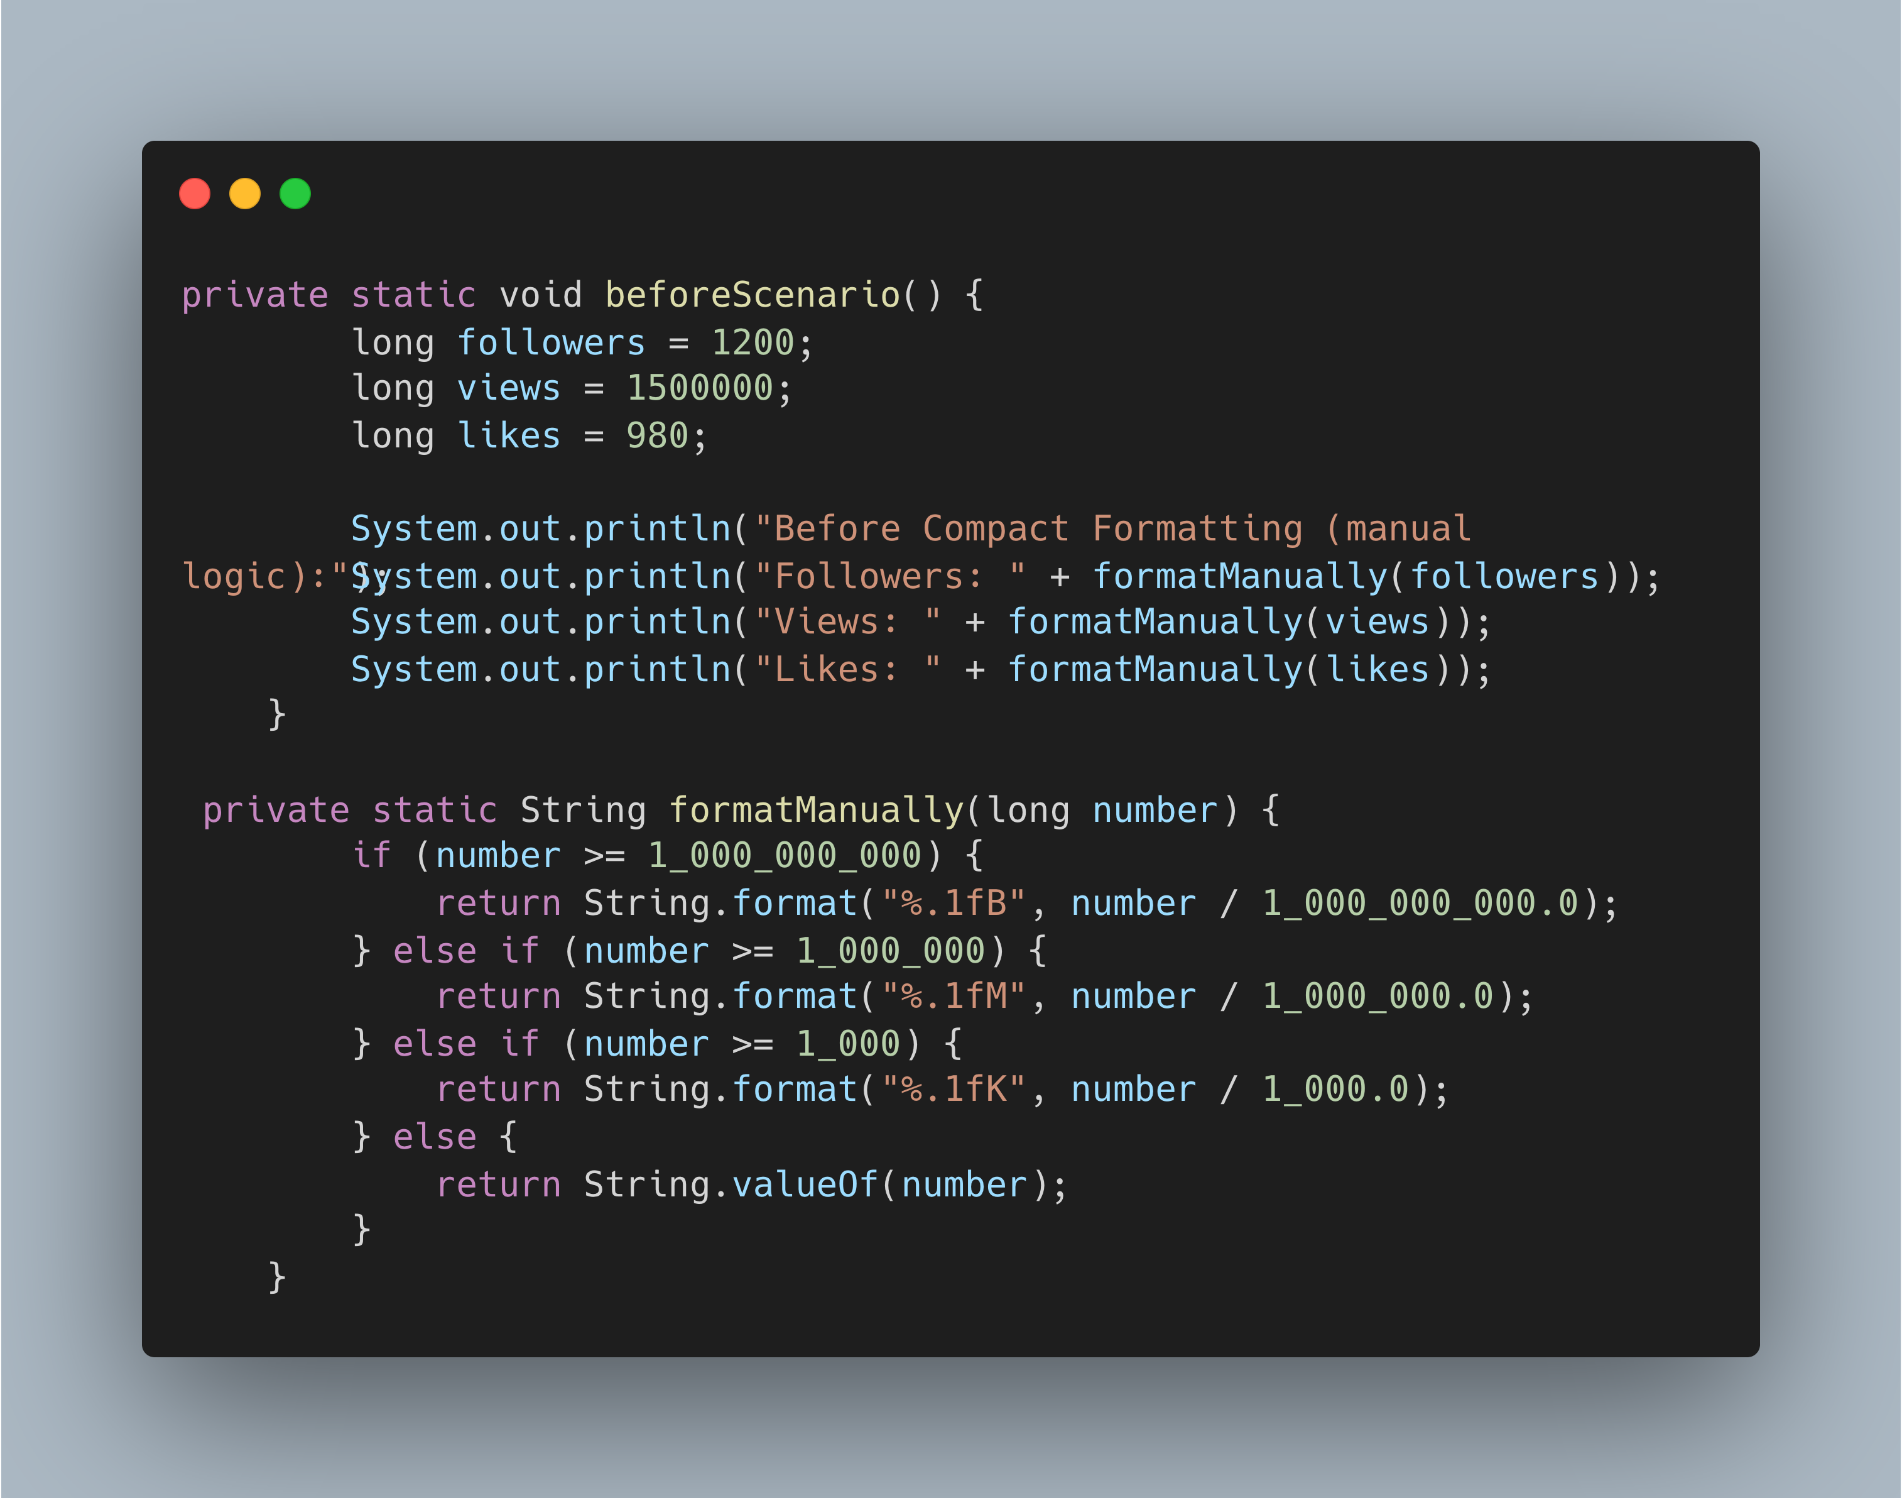

Slide 14
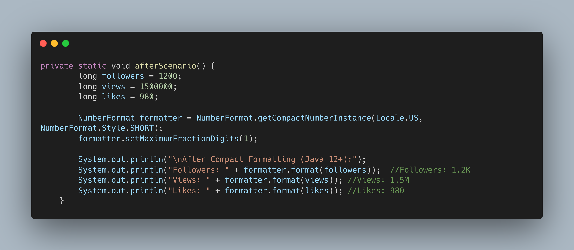

Slide 15
Enhanced switch Expressions
What:
Introduced as standard in Java 14
Allows a switch to be used as an expression that returns a value
Supports arrow syntax (->) and yield
Why:
Eliminates the need for break and fall-through cases
Great for returning values directly from switch, improving readability and maintainability

Slide 16
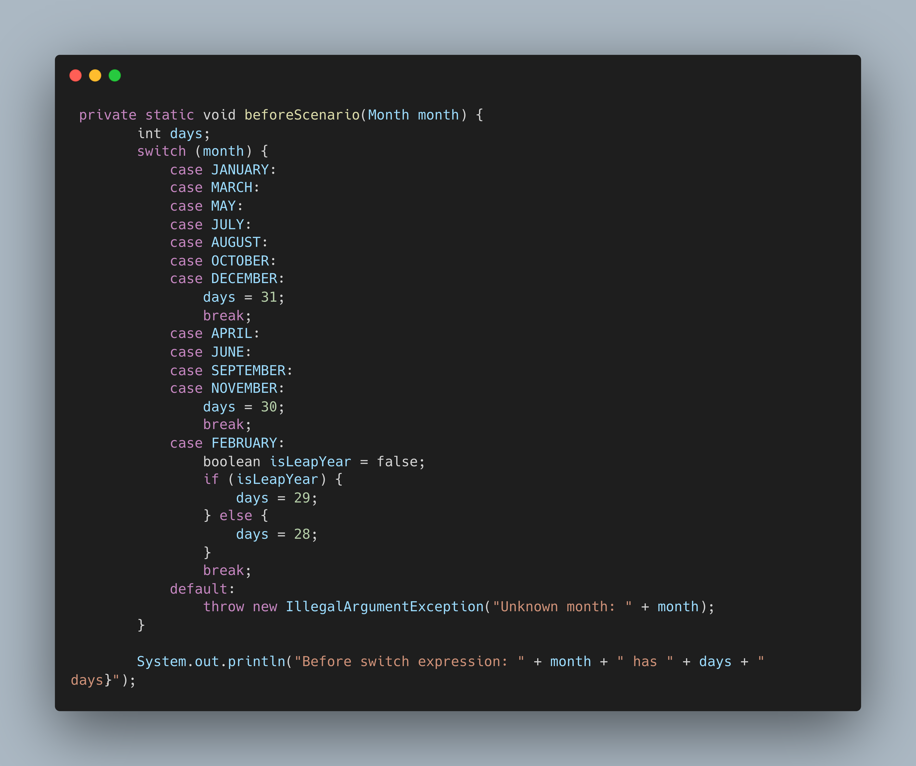

Slide 17
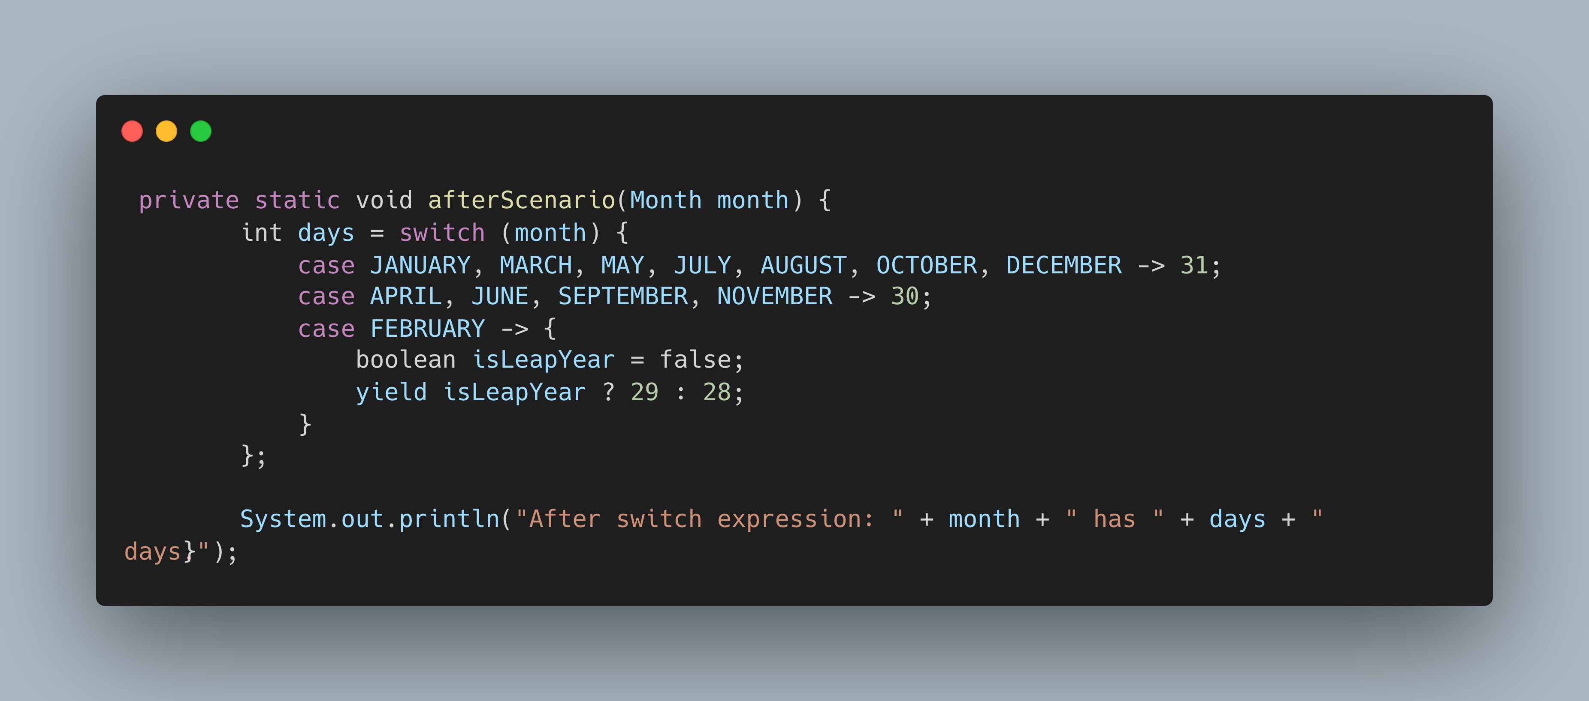

Slide 18
Text blocks
What:
Introduced in Java 15 (standard)
Allows writing multi-line strings using the """ syntax
Why:
Improves readability of JSON, SQL, XML, and HTML

Slide 19
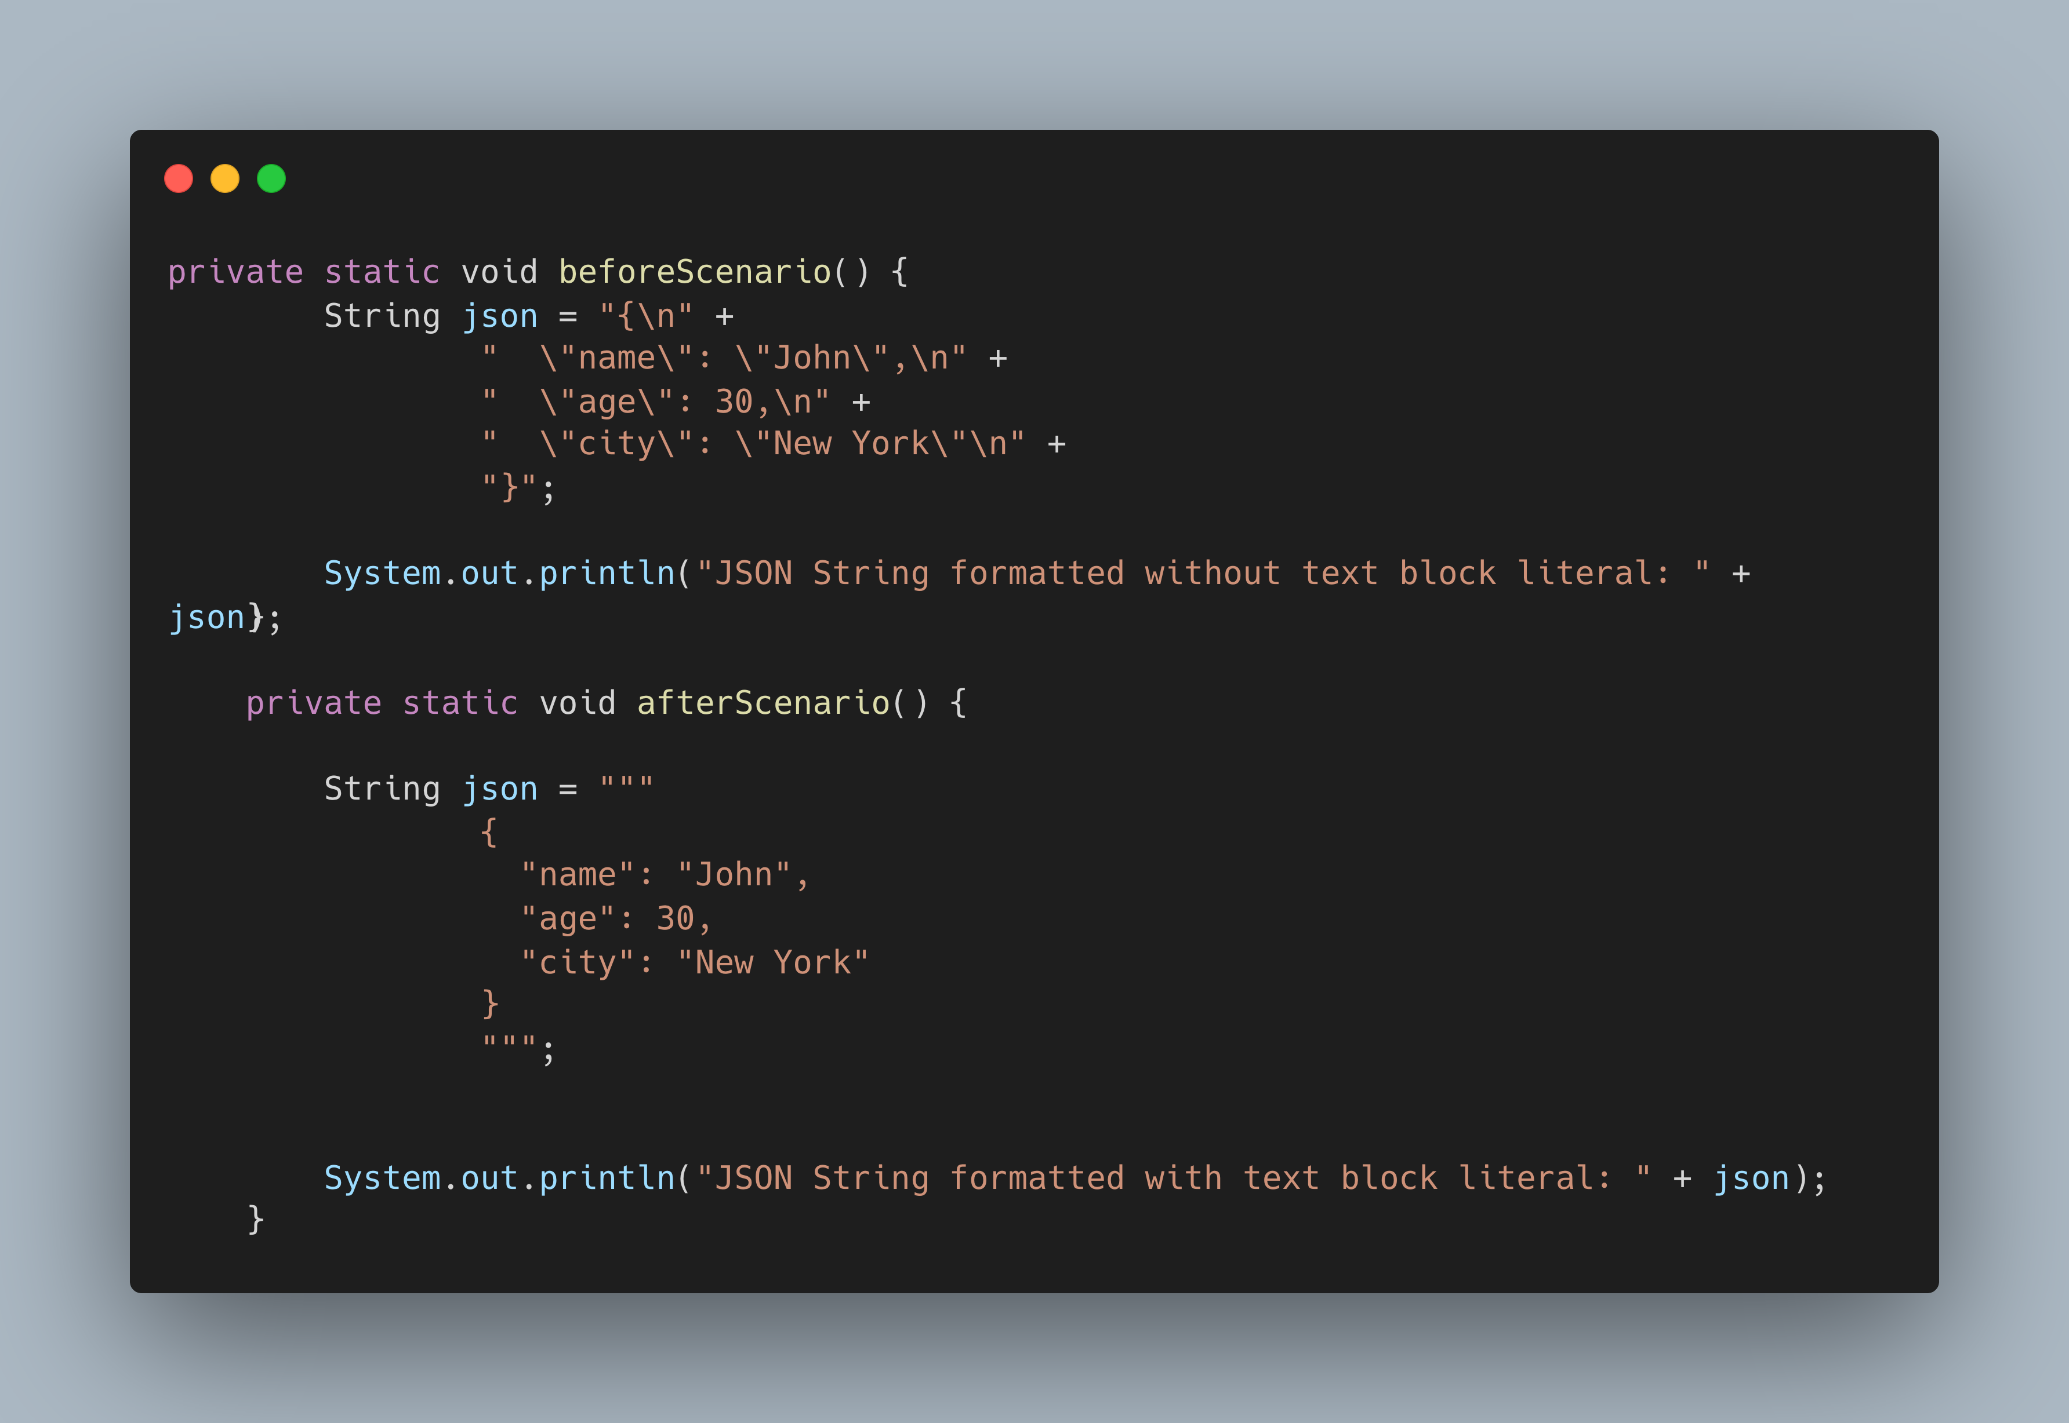

Slide 20
Records
What:
Introduced in Java 16 (standard)
Compact syntax for declaring immutable data carriers
Auto-generates: Constructor, Getters, equals(), hashCode(), toString()
Why:
Eliminates boilerplate code in POJOs
Enhances readability and intent clarity
Ideal for DTOs, event models, and value objects

Slide 21
Pattern Matching for instanceof
What:
Introduced in Java 16 (standard)
Allows type check and cast in a single step
Simplifies the usage of instanceof with pattern binding
Why:
Removes redundant casting
Improves code clarity and safety
Enables more concise and readable conditional logic

Slide 22
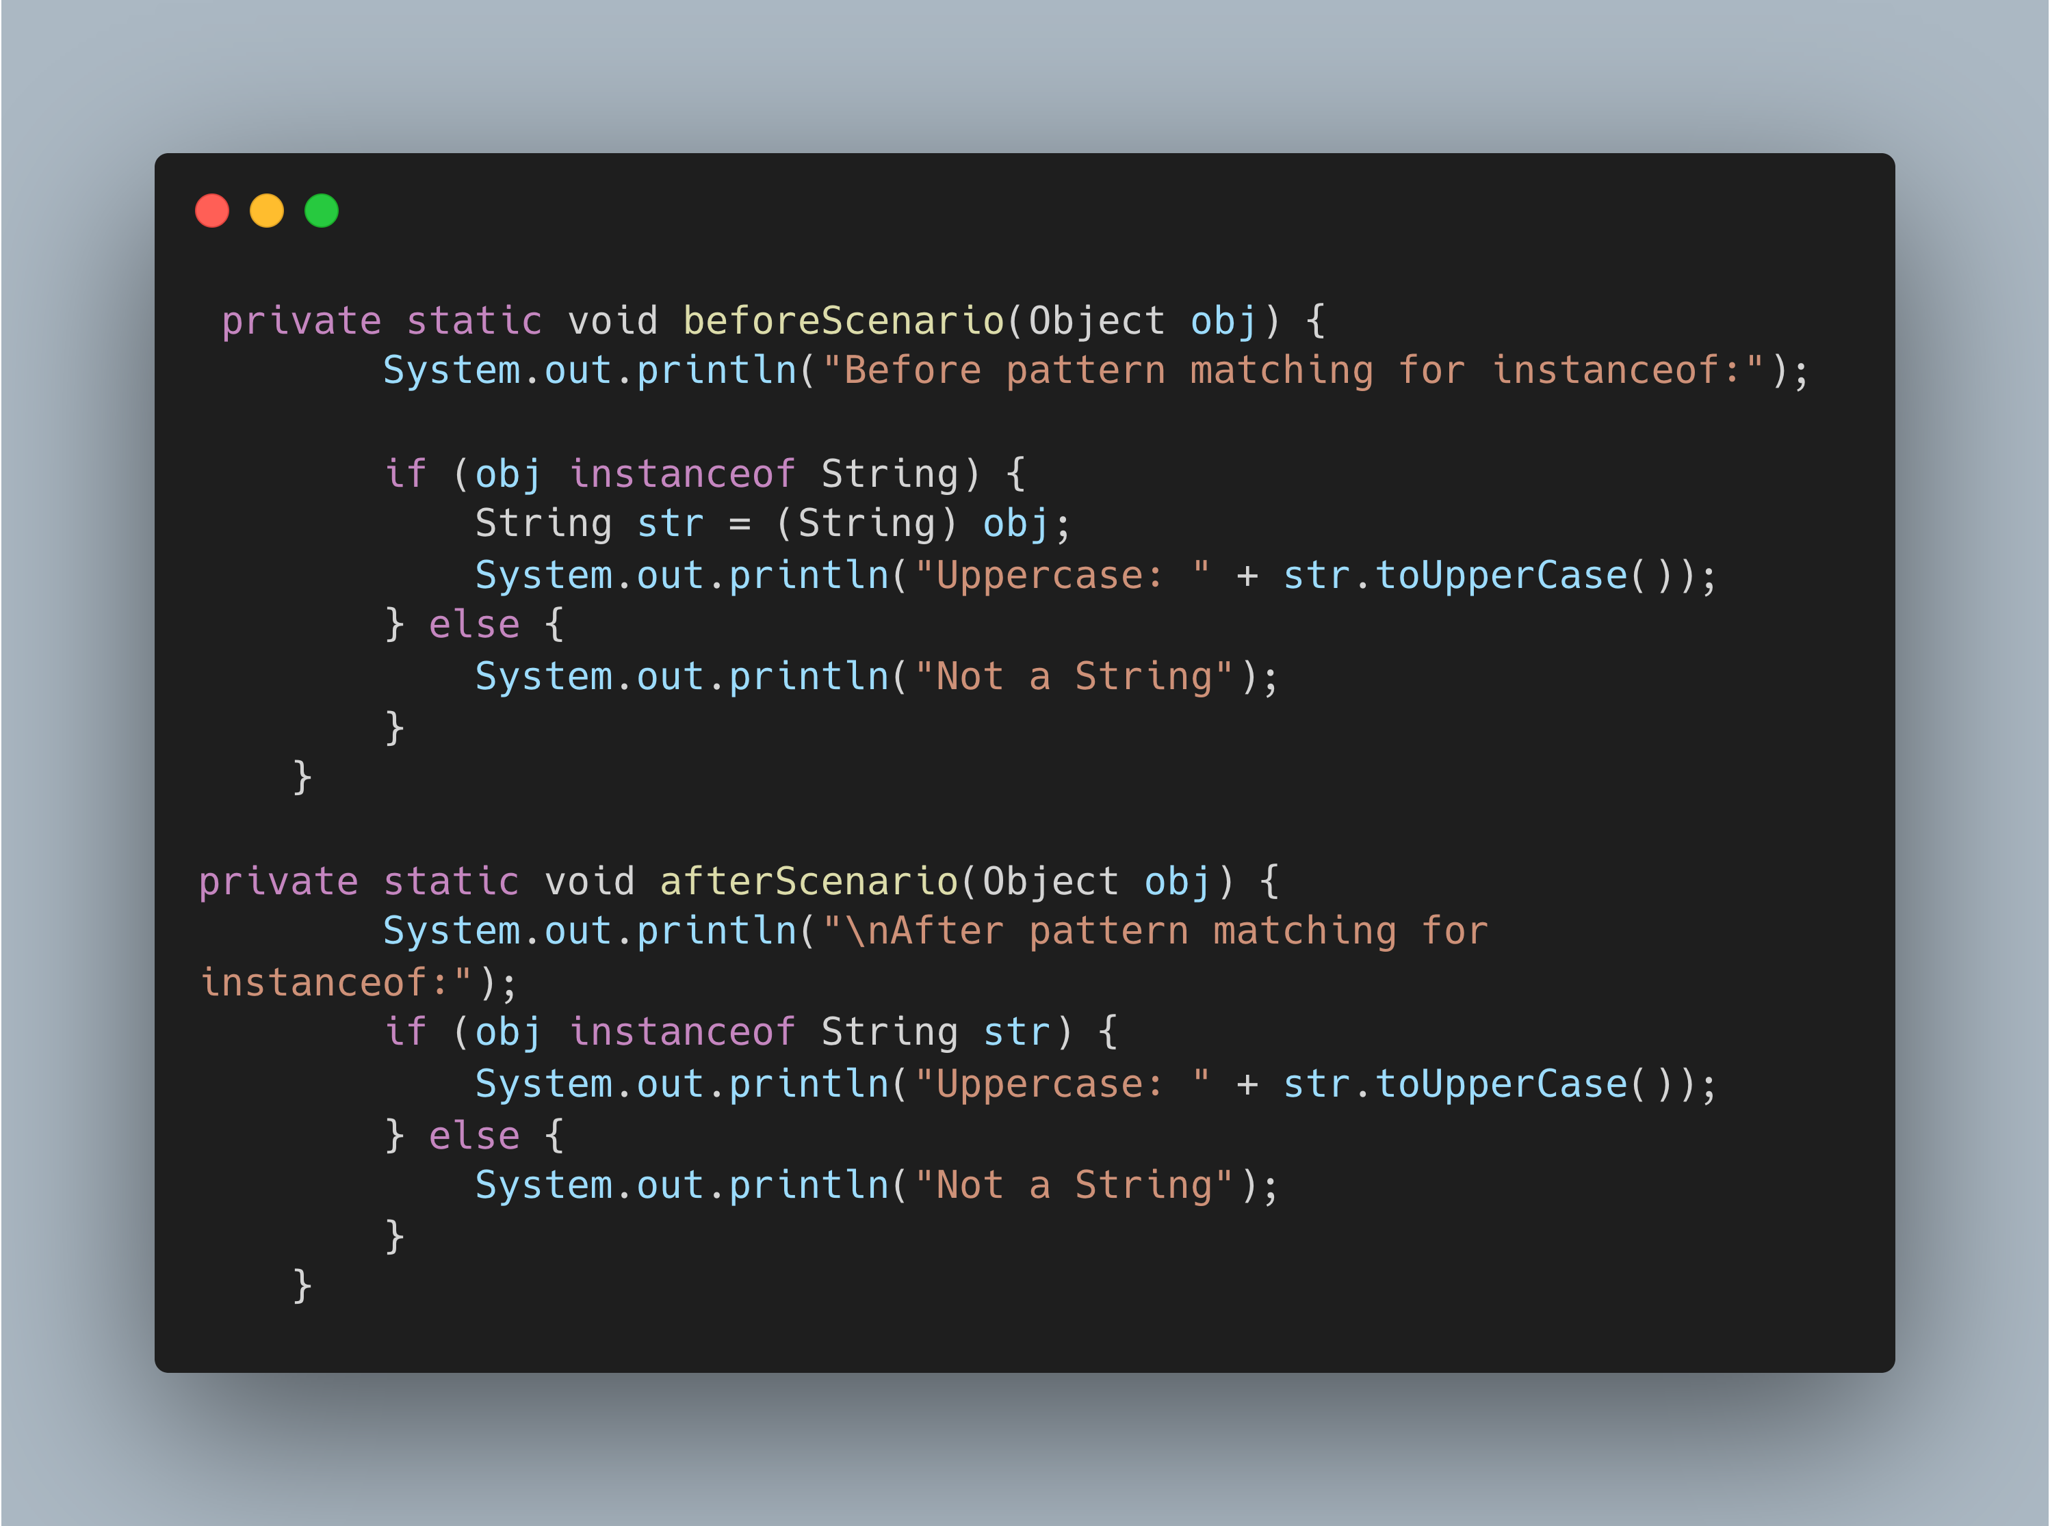

Slide 23
Sealed Types
What:
Introduced in Java 17 (standard)
Allow a class or interface to restrict which other classes may extend or implement it
Why:
Provide explicit control over type hierarchies
Improve code safety and intent clarity

Slide 24
Pattern Matching for switch
What:
Standardized in Java 21
Enhances the switch to support type patterns and guarded patterns
Works with objects, records(Stadardized in Java 22), and sealed types
Why:
Makes the switch more powerful and expressive
Eliminates the need for multiple if-else instanceof blocks

Slide 25
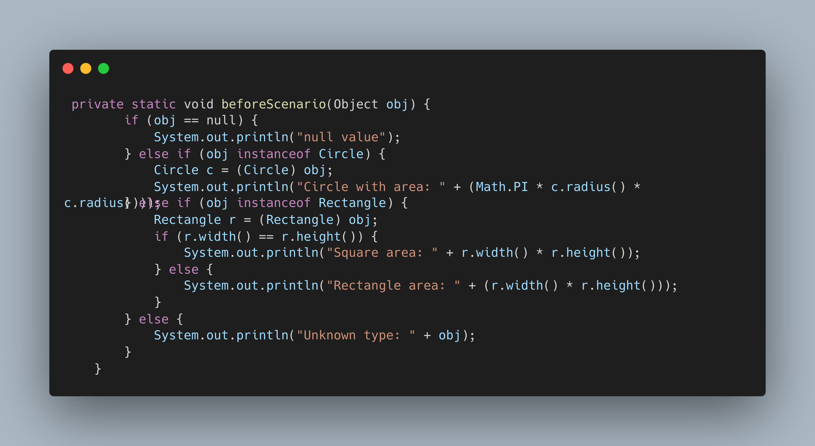

Slide 26
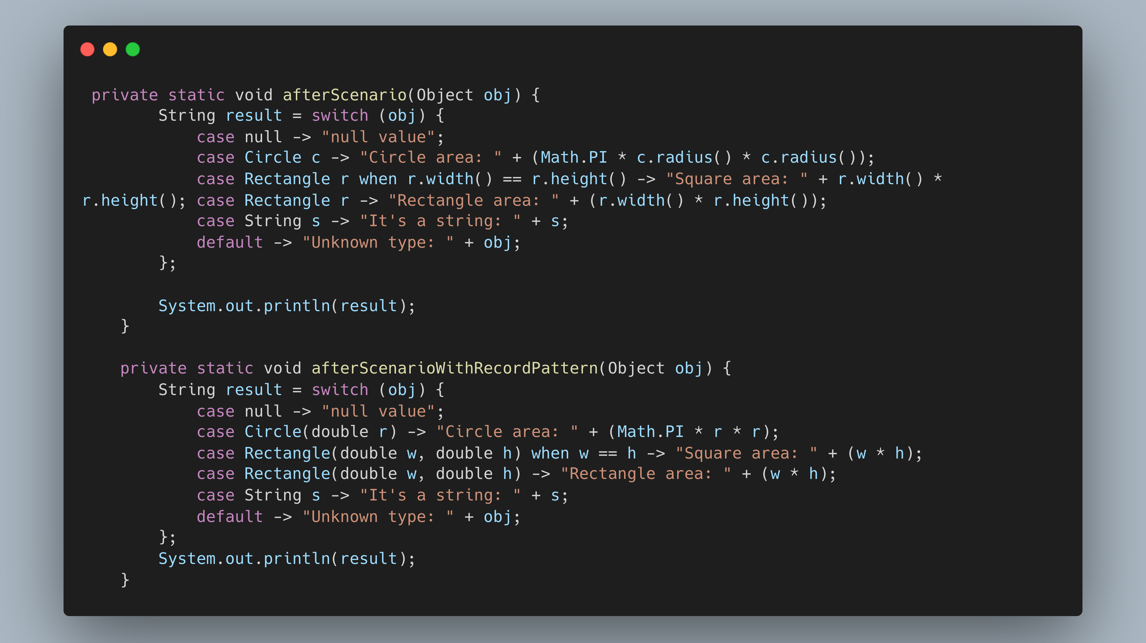

Slide 27
Stream Gatherers
What:
Introduced in Java 24 (standard)
Allows creation of custom intermediate operations
(e.g., windowing, grouping, filtering with memory) Why:
Expands the flexibility of Stream pipelines
Enables stateful, composable, and reusable stream operations
Promotes cleaner code for complex stream transformations

Slide 28
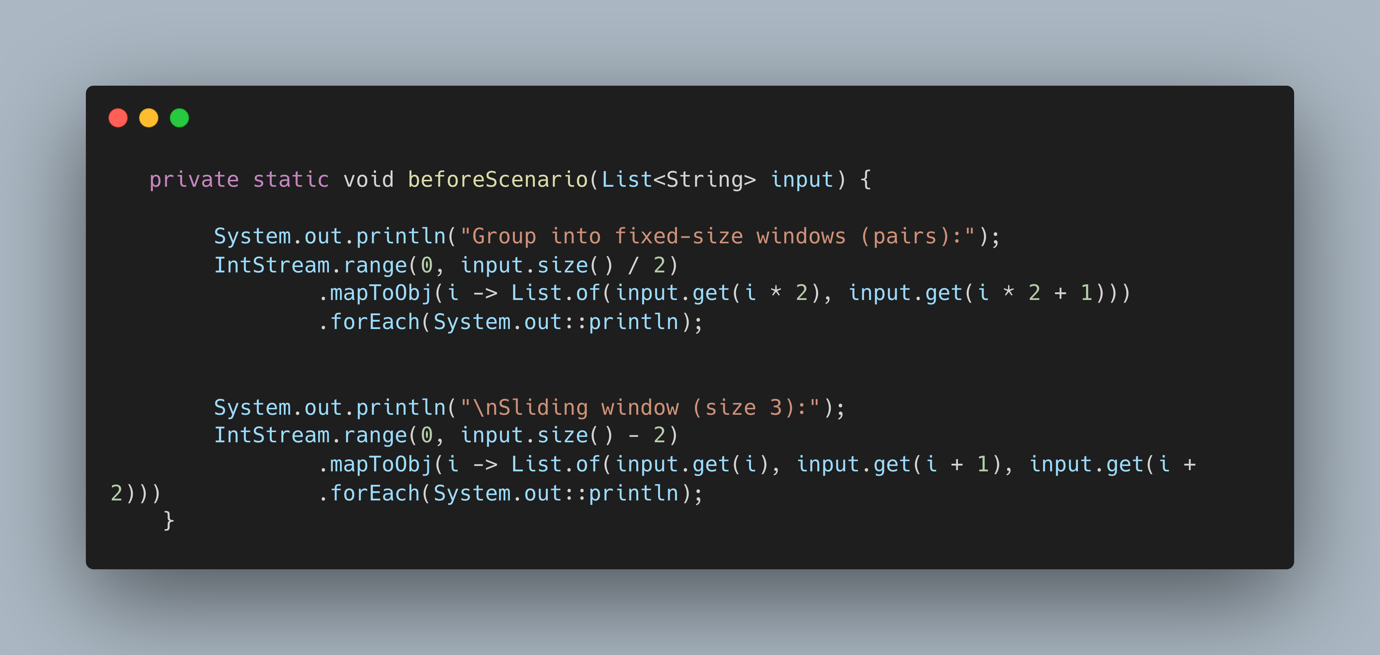

Slide 29
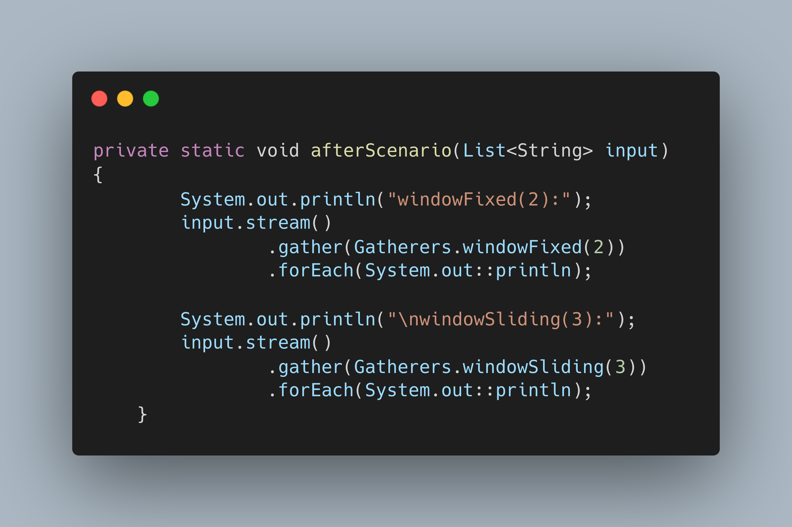

Slide 30
Thank you

